Slide 1
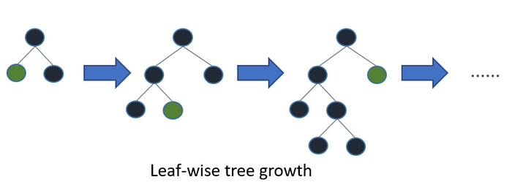
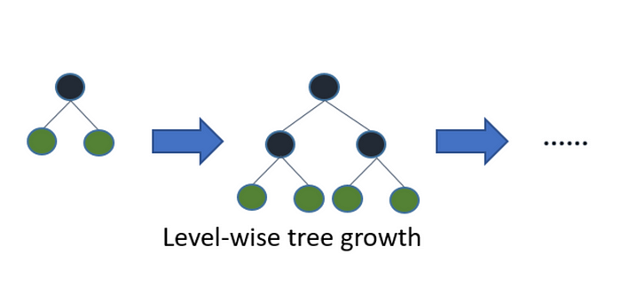
Light GBM
Light GBM is a gradient boosting framework that uses tree based learning algorithm.
Light GBM grows tree vertically while other algorithm grows trees horizontally meaning that Light GBM grows tree leaf-wise while other algorithm grows level-wise.

Slide 2
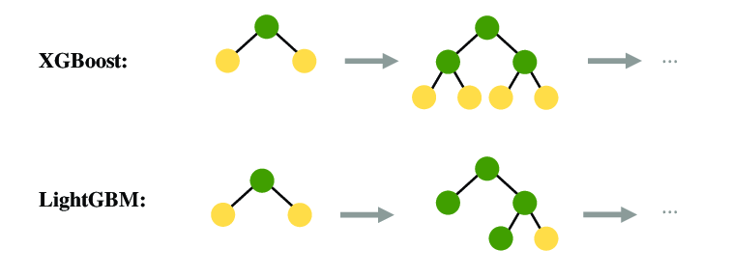

Slide 3
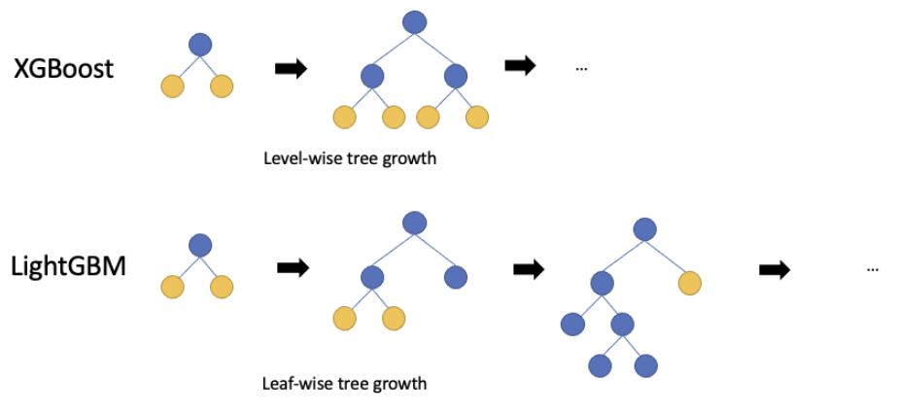

Slide 4
Install LGBoost by running the following command:
!pip install lightgbm
Import the LGBoost regressor by adding the following line:
from lightgbm import LGBMRegressor
For reference : https://lightgbm.readthedocs.io/en/latest/pythonapi/lightgbm.LGBMRegressor.html

